Slide 1
IT 304 Computer Networks Fundamentals Week 1-Lecture 3

Slide 2
Today’s lecture
Internet
Big picture View
Service view
Components of a network
Edge, access and core
Performance metrics
Cont.. performance metrics

Slide 3

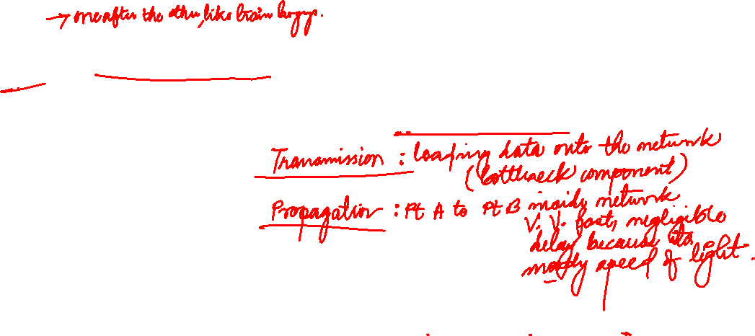

Host: sends packets of data
host sending function:
takes application message
breaks into smaller chunks, known as packets, of length L bits
transmits packet into access network at transmission rate R
link transmission rate, aka link capacity, aka link bandwidth
two packets,
L bits each
2
1
R: link transmission rate
host
time needed to
transmit L-bit
packet into link
=
L (bits)
R (bits/sec)

Slide 4




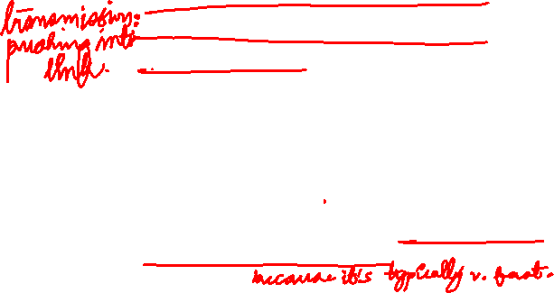
Packet-switching: store-and-forward
L bits
per packet
source
3
2
1
R bps
R bps
destination
takes L/R seconds to transmit (push out) L-bit packet into link at R bps
store and forward: entire packet must arrive at router before it can be transmitted on next link
one-hop numerical example:
L = 7.5 Mbits
R = 1.5 Mbps
one-hop transmission delay = 5 sec
end-end delay = 2L/R (assuming zero propagation delay)
more on delay shortly …

Slide 5
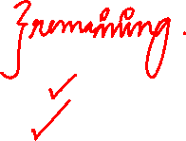
What are the main components of delay when we use packet switching?
Processing delay
queuing delay
transmission delay
propagation delay

Slide 6

Four sources of packet delay
C
transmission
A
propagation
D
B
nodal
processing
queueing
d_{nodal} = d_{proc} + d_{queue} + d_{trans} + d_{prop}
d_{trans}: transmission delay: func(L, R)
L: packet length (bits)
R: link bandwidth (bps)
d_{trans} = L/R
d_{prop}: propagation delay: func(d)
d: length of physical link
s: propagation speed (~2x10⁸ m/sec)
d_{prop} = d/s
d_{trans} and d_{prop}
very different
* Check out the online interactive exercises for more examples:
Notes:
6

Slide 7

Four sources of packet delay
transmission
A
propagation
B
nodal
processing
queueing
d_{nodal} = d_{proc} + d_{queue} + d_{trans} + d_{prop}
d_{proc}: nodal processing
check bit errors
determine output link
typically < msec
d_{queue}: queueing delay
time waiting at output link for transmission
depends on congestion level of router

Slide 8
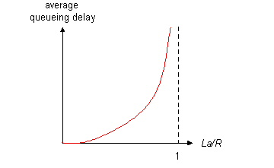

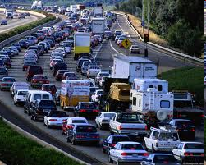
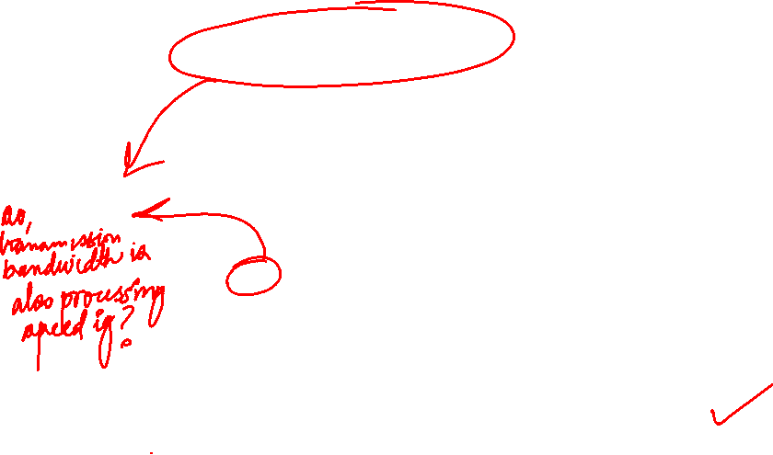

Queueing delay
R: link bandwidth (bps)
L: packet length (bits)
a: average packet arrival rate
average queueing delay
traffic intensity
= La/R
La/R ~ 0: avg. queueing delay small
La/R -> 1: avg. queueing delay large
La/R > 1: more “work” arriving
than can be serviced, average delay infinite!
La/R ~ 0
La/R -> 1
* Check online interactive animation on queuing and loss

Slide 9

Delay factor contributions to Total Delay
d_{prop}
for a link connecting two routers on the same university campus → negligible
for two routers interconnected by a satellite link(100s km) → 100+ milliseconds
d_{trans}
> bandwidths (10 Mbps and higher) → negligible [more bits/sec]
If large Internet packets sent over low-speed dial-up modem links → hundreds of milliseconds .
d_{proc} is often negligible
Super fast routers

Slide 10
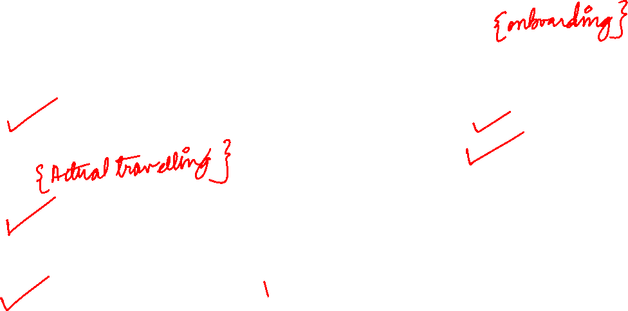
Propagation delay is defined as the time taken for bits in a packet to go over a transmission link.
A. True
B. False
Propagation delay is a function of
A. Distance
B. Bandwidth
C. Packet size
D. Speed of light in a medium
Tranmission delay is a function of
A. Distance
B. Speed of light in a medium
C. Bandwidth
D. Packet size

Slide 11

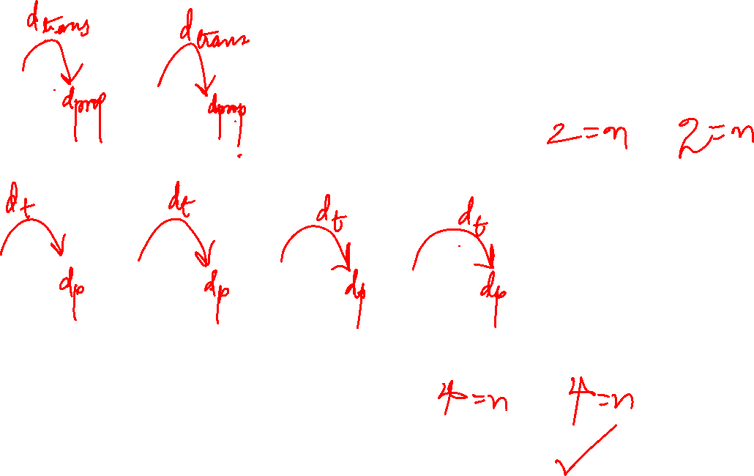
# dtrans | #dprop
Total delay =
# dtrans | #dprop
Total delay =
d_{End-End} =N(d_{proc} + d_{queue} + d_{trans} + d_{prop})

Slide 12
Packet Switching: queueing delay, loss
R = 100 Mb/s
C
A
D
R = 1.5 Mb/s
B
E
queue of packets
waiting for output link
queuing and loss:
if arrival rate (in bits) to link exceeds transmission rate of link for a period of time:
packets will queue, wait to be transmitted on link
packets can be dropped (lost) if memory (buffer) fills up

Slide 13
How do loss and delay occur?
packets queue in router buffers
packet arrival rate to link (temporarily) exceeds output link capacity
packets queue, wait for turn
packet being transmitted (delay)
A
B
packets queueing (delay)
free (available) buffers: arriving packets
dropped (loss) if no free buffers

Slide 14
Packet loss
queue (aka buffer) preceding link in buffer has finite capacity
packet arriving to full queue dropped (aka lost)
lost packet may be retransmitted by previous node, by source end system, or not at all
buffer
(waiting area)
A
packet being transmitted
B
packet arriving to
full buffer is lost
* Check out the Java applet for an interactive animation on queuing and loss

Slide 15
Throughput
throughput: rate (bits/time unit) at which bits transferred between sender/receiver
instantaneous: rate at given point in time
average: rate over longer period of time
server, with
file of F bits
to send to client
link capacity
R_{s} bits/sec
link capacity
R_{c} bits/sec
server sends bits
(fluid) into pipe
pipe that can carry
fluid at rate
R_{s} bits/sec)
pipe that can carry
fluid at rate
R_{c} bits/sec)

Slide 16

If four routers are separated by 10km, but with different capacity optical fibre cables, which delay component will be constant and which one will vary?
A. d_{prop} constant, d_{trans} varying
B. d_{prop} varying, d_{trans} varying
C. d_{prop} varying, d_{trans} constant
D. d_{prop} constant, d_{trans} constant

Slide 17
“Real” Internet delays and routes
what do “real” Internet delay & loss look like?
traceroute program: provides delay measurement from source to router along end-end Internet path towards destination. For all i:
sends three packets that will reach router i on path towards destination
router i will return packets to sender
sender times interval between transmission and reply.
3 probes
3 probes
3 probes

Slide 18

Throughput (more)
R_{s} < R_{c} What is average end-end throughput?
R_{s} bits/sec
R_{c} bits/sec
R_{c} < R_{s} What is average end-end throughput?
R_{s} bits/sec
R_{c} bits/sec
bottleneck link
link on end-end path that constrains end-end throughput
Or the ACCESS NETWORK

Slide 19


Throughput: Internet scenario
per-connection end-end throughput: min(R_{c},R_{s},R/10)
in practice: R_{c} or R_{s} is often bottleneck
R_{s}
R_{s}
R_{s}
10 connections (fairly) share backbone bottleneck link R bits/sec
R
bottleneck link
R_{c}
R_{c}
SHARED LINK IN THE CORE
R_{c}
Throughput depends not only on the transmission rates of the links along the path, but also on the intervening traffic

